Slide 1
Unit Testing
“I don’t have time to write tests because I am too busy debugging.”
ThanhPham

Slide 2
What to be discussed?
The concepts of Unit Testing
Unit Test is lack of time
Types of software testing
Simple Unit Test with JUnit
JUnit for beginner
What’s next?

Slide 3
The Concept of Unit Testing
A unit test is code written by a developer that tests as small a piece of functionality (the unit) as possible.
One function may have multiple unit tests according to the usage and outputs of the function.
The percentage of code which is tested by unit tests is typically called test coverage
Tests ensure
The code meets expectations and specifications: Does what it says it should do.
The code continues to meet expectations over time: Avoiding regression.
Unit Test is NOT about finding bugs

Slide 4
Types of Software Testing
Unit Testing (do the parts perform correctly alone?)
Integration Testing (do the parts perform correctly together?)
User Acceptance Testing (does the system meet the end user’s expectations?)

Slide 5
Unit Testing vs. Integration Testing
Unit Testing tests one layer
User Interface
Business Entity
Data Access Layer
Data Layer
Integration Testing tests across layers.

Slide 6
Unit Test is lack of time?
How does Unit Test waste your time…

Slide 7
1001 reasons of not to write UT
Why do I need to write UT?
Writing UT is waste of time.
Deadline is coming…I don’t have time for UT.
I can test by hand…why ask me to write UT?
It’s simply not my job!
My code is very simple, I don’t need to write UT for it.
I’m a great developer…my code is just correct. Don’t need to test. Ha ha ☺
……

Slide 8
Some questions….
How do you ensure your code work as expected?
You want spend 5 minutes for UT or 55 minutes for debugging?
Why do you ask tester do something that belong to you?
There are no such a thing like a great developer in the world :D

Slide 9
What UT brings to you?
An easiest way to test your code.
Give you more confidence about your code.
Avoid regression test.
In ideally, UT work as a very good document for dev as well as tester.
An easy way for you to duplicate a bug.
Very good for negative testing
UT force you to slowdown and think about your design.

Slide 10
Structure of a Unit Test
Unit Test Hierarchy and Structure of a Unit Test…

Slide 11
Unit Test Hierarchy
Test Project
Test Fixture
Test
Test
Test Fixture
Test
Test
Test
Test
Test
Test
One per assembly
One per class
One per unit (not necessarily per method)

Slide 12
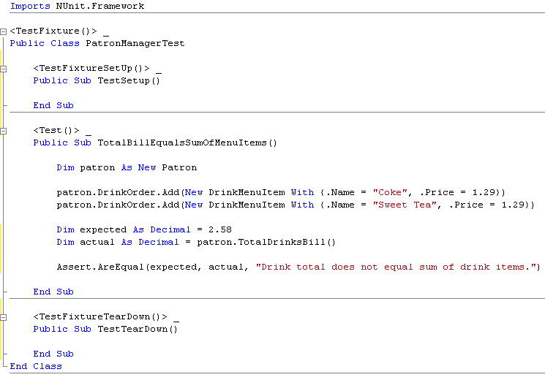
Structure of A Unit Test
Setup
Prepare an input
Call a method
Check an output
Tear down

Slide 13
Test Assertions
Assertions are the ‘checks’ that you may perform to determine if a test passes or fails.
For instance:
Assert.IsTrue()
Assert.IsInstance()
Assert.AreEqual()
Generally speaking, you want ONE assertion per test.

Slide 14
Unit Test with JUnit
What is Junit? What does it bring to us? How to apply?

Slide 15
What is JUnit
JUnit is a unit testing framework for the Java programming language.
JUnit has been important in the development of test-driven development.

Slide 16
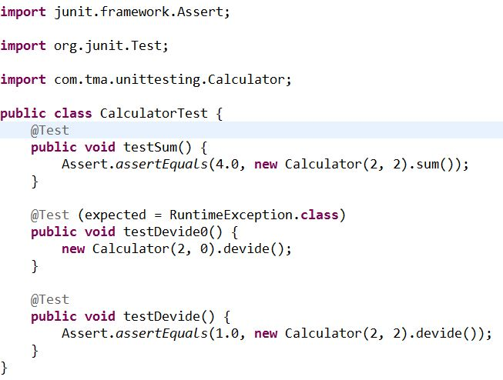
Simple UT with JUnit

Slide 17
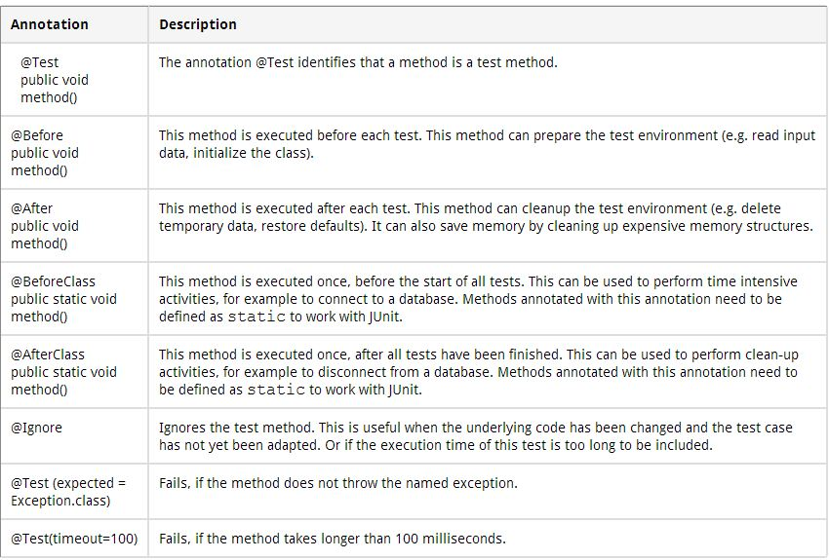
JUnit annotations

Slide 18
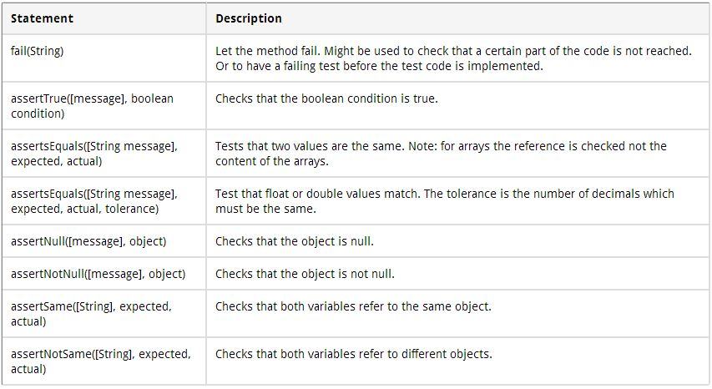
Assert statements

Slide 19
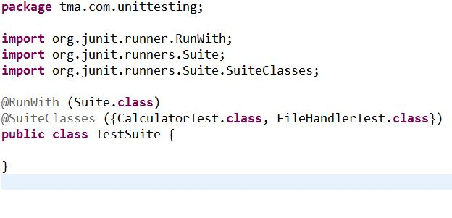
Test Suite
If you have several test classes you can combine them into a test suite. Running a test suite will execute all test classes in that suite.

Slide 20
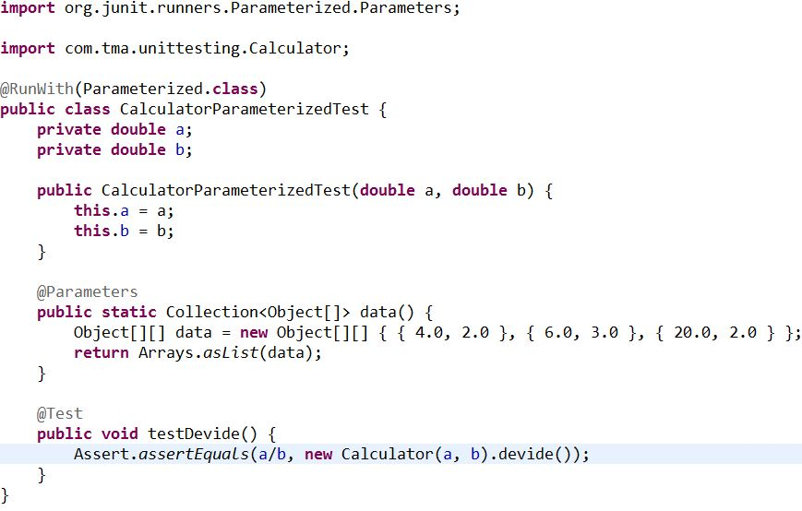
Parameterized test

Slide 21
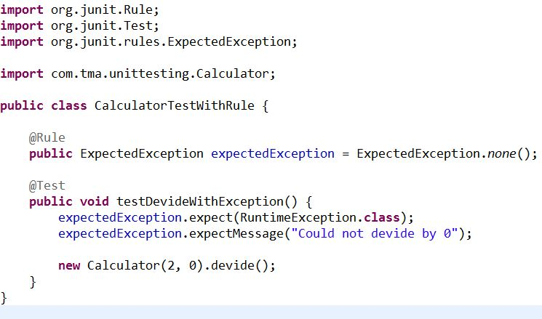
Rules
@Rule annotation enables you to create objects which can be used and configured in your test methods.
Some rules: ExpectedException, TemporaryFolder

Slide 22

Life without UT

